Slide 1
Fake news - conspiracy theories
Hana Liškařová, VUT FIT 2025

Slide 2
Overview
What is a conspiracy theory, what makes it believable
How does a conspiracy theory spread and why do we fall for them
Conspiracy theories that turned out to be right
My favourite ones

Slide 3
What is a conspiracy theory?

Slide 4


Slide 5
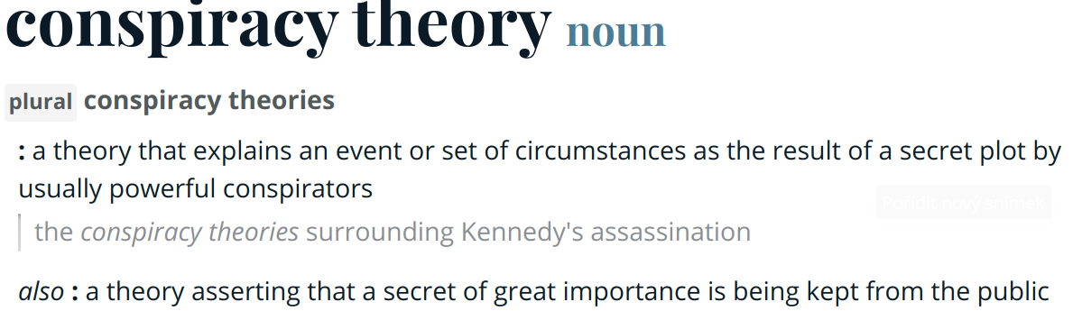
Merriam Webster dictionary

Slide 6
What makes it believable?
convincing culprit
collective anxiety
themes of conspiracies vary greatly depending on culture and region
tribalism, nationalism, us versus them mentality
uncertainty, fear
seeking reassurance or meaning
knowledge gaps
mistrust

Slide 7
Shared outline - How to make your own conspiracy theory successfully
Locate the source of unusual social and political phenomena in unseen, intentional and malevolent forces
Interpret political events in terms of the struggle between good and evil
Make people believe that mainstream reporting of public affairs is a ruse or an attempt to distract the public from a true source of power

Slide 8
How do they spread and why do we fall for them?

Slide 9
Why do we fall for them?
they confirm what we want to believe
comfort
they provide someone to blame for tragedies and unexplainable situations

Slide 10
Spreading and biases
Confirmation bias
Disconfirmation bias
Attitude-congruence bias
Notes:
Confirmation Bias or Biased Assimilation: A person is more likely to seek out information that is consistent with their pre-existing beliefs, while simultaneously avoiding incompatible information that may challenge their beliefs.
Disconfirmation bias: A person will spend more time and effort denigrating and counterarguing opposing arguments.
Attitude-congruence bias: Those who hold a definite position on an issue tend to see supporting arguments as stronger than opposing arguments

Slide 11
The ones that turned out to be true

Slide 12
The ones that turned out to be true
MKUltra: the CIA Mind-Control Project
development of the “truth serum” by forcing LSD on people and torturing them
CIA Assassinations
uncovering of assassinations on leaders and prominent figures in Central and South America, Africa, the Middle East and Eastern Asia
assassinations appeared like car accidents, suicides, cancers, and heart attacks
Operation Mockingbird: The CIA Propaganda Machine
3,000 CIA employees and dozens of large global media outlets working to maintain a complex propaganda machine
mostly anti-communism propaganda

Slide 13
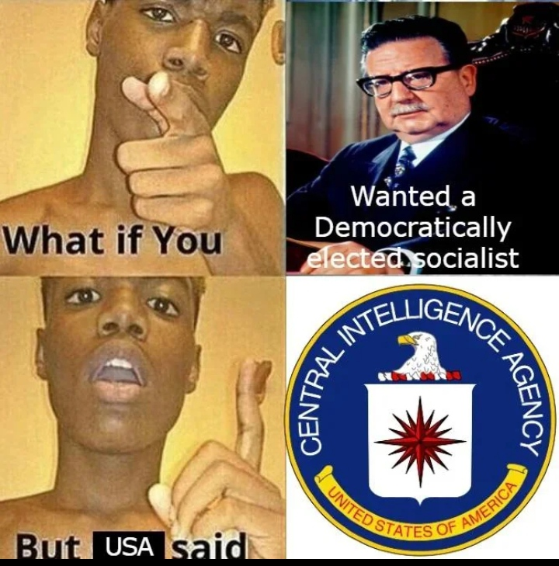
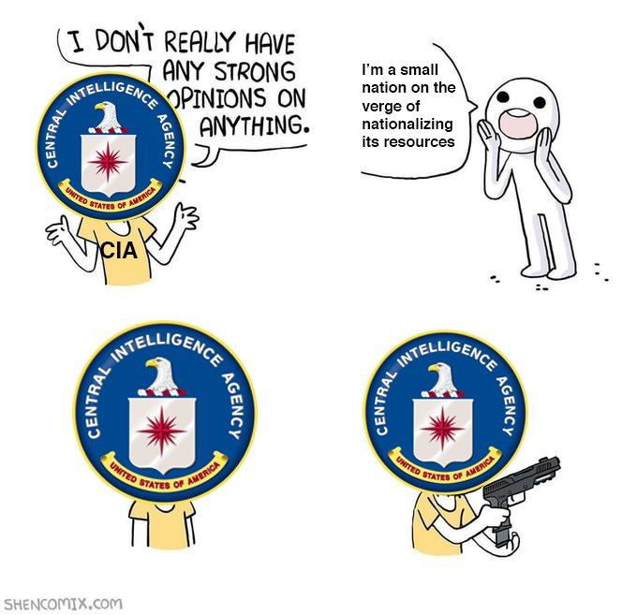

Slide 14
The ones that turned out to be true
Operation Paperclip: Nazi Scientists Find Employment in America
COINTELPRO: The FBI vs. 1960s Activists
marginalizing, infiltrating and disrupting groups, such as the women’s rights movement, the non-violent civil rights movement, the Congress of Racial Equality, the American Indian Movement, and other civil rights groups
Operation Northwoods: How to Wage War on Cuba
CIA planned staged terrorist attacks on American citizens and military targets in Miami and Washington, intentionally blame it on the Cuban government and convince the American public to wage war on Cuba
thankfully rejected by JFK

Slide 15
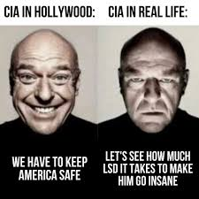
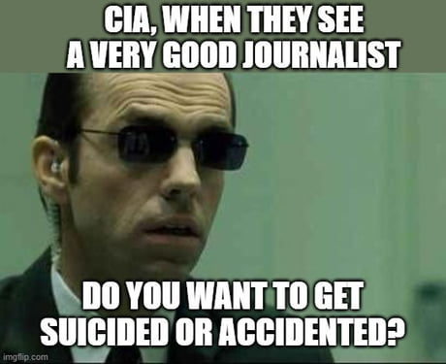

Slide 16
Interesting examples

Slide 17
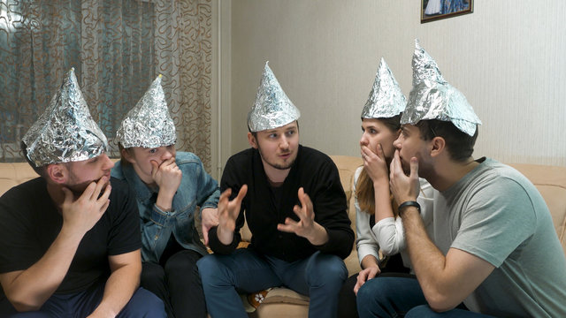
Mind control by magnetic radiation
individuals believe they are being specifically targeted by the government or big corporations
wide spread, support groups, facebook communities
tin foil hats to shield the brain
The Tissue-Culture King, 1927

Slide 18
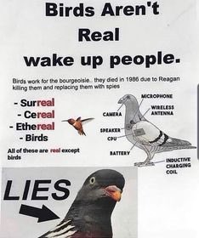
Birds aren’t real
originaly a satirical conspiracy theory
birds are not real but drones operated by the government
birds sit on power lines to recharge
“If it flies it spies”
massive surge in popularity during covid
lockdowns supposedly enforced so real birds could be changed for drones

Slide 19
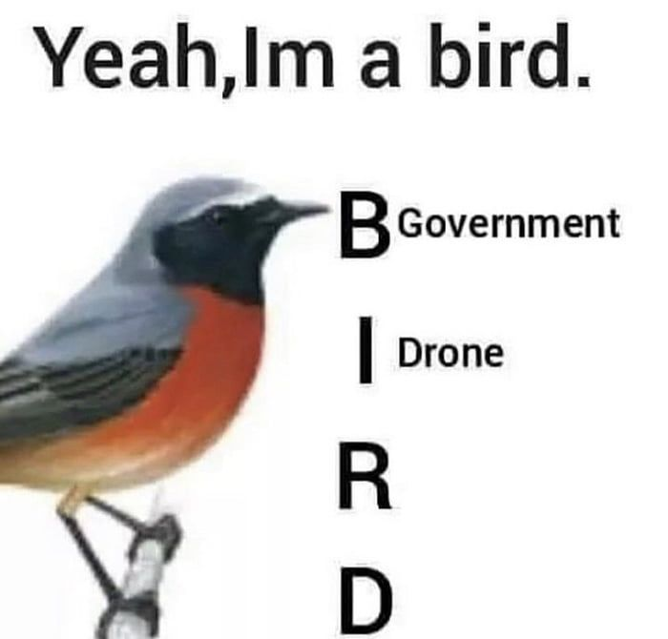
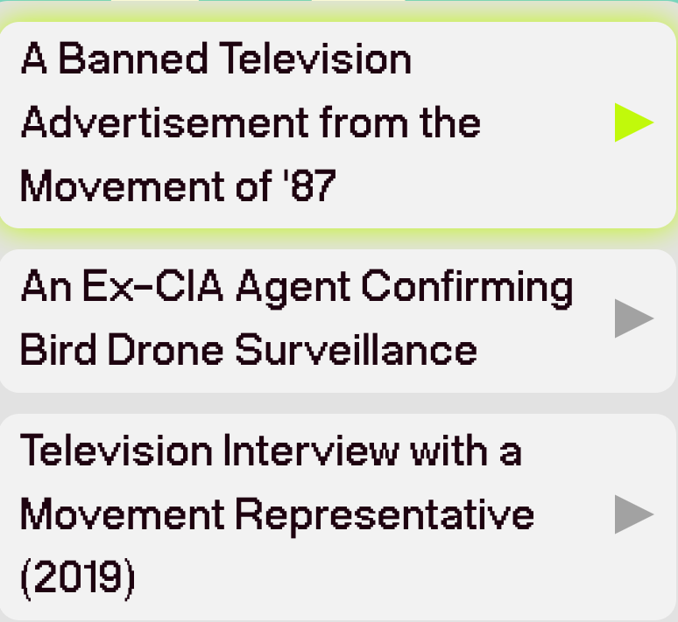
“proof” from the official webpage of the movement - birdsarentreal.com

Slide 20
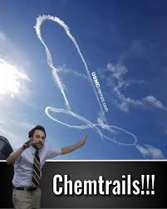
Chemtrails
long-lasting condensation trails left in the sky by high-flying aircraft
chemical or biological agents, sprayed for nefarious purposes undisclosed to the general public
theories range from weather control, population control to chemical warfare
government purposefully turning people gay

Slide 21
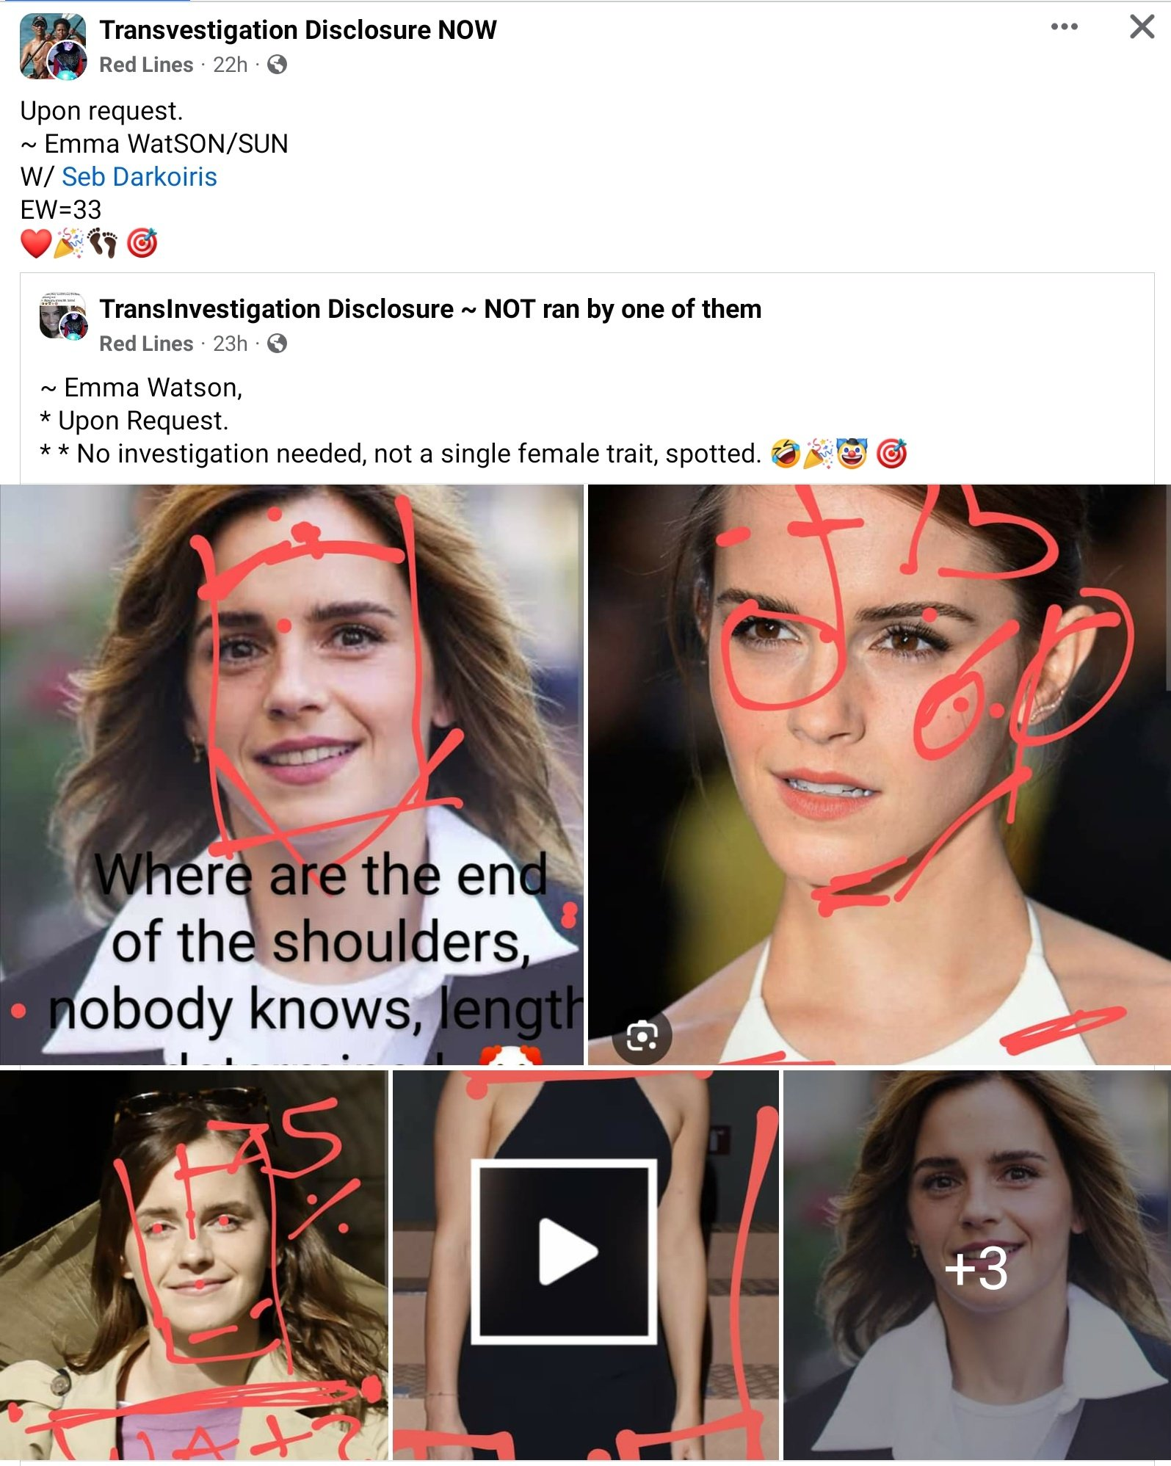
Transvestigation
very popular on facebook and X
belief that celebrities and other prominent figures are transgender
elite gender inversion as an initiation tutorial

Slide 22
Sources
https://history.howstuffworks.com/history-vs-myth/11-unbelievable-conspiracy-theories-that-were-actually-true.htm
https://en.wikipedia.org/wiki/List_of_conspiracy_theories
https://newsroom.ucla.edu/releases/how-conspiracy-theories-emerge-and-fall-apart
https://en.wikipedia.org/wiki/Transvestigation
https://cs.wikipedia.org/wiki/Chemtrail
https://www.bbc.com/future/article/20200522-what-we-can-learn-from-conspiracy-theories
https://www.merriam-webster.com/dictionary/conspiracy%20theory
https://en.wikipedia.org/wiki/Tin_foil_hat
https://en.wikipedia.org/wiki/Birds_Aren%27t_Real
https://birdsarentreal.com/pages/about

